Slide 1
Design Patterns
Case Study:
Designing A Document Editor
Tech Lunch
Bill Kidwell
Notes:
Instructor notes
[Copy and paste this text box on notes pages for all slides]

Slide 2
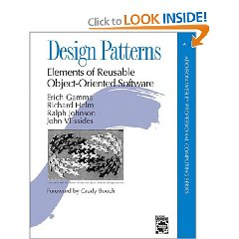
The Plan
Design Patterns: Elements of Reusable Object-Oriented Design
  Review the Case Study in the book
  7 Design Problems
  Discuss each design problem
  Review their solution
    Where do we agree?
    Disagree?
    Agree to disagree?
Notes:
Instructor notes
[Copy and paste this text box on notes pages for all slides]

Slide 3
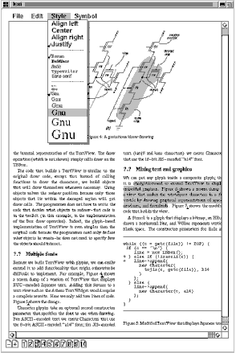
Lexi
Features
WYSIWYG Document Editor
Mix text and graphics in a variety of styles
pull-down menus
scrollbars
Icons for jumping to a particular page

Slide 4
Design Problems
Quick: We will explore each
Document Structure
      How do we represent a document?
Formatting
      How do we arrange text and graphics on the screen (or paper)
Embellishing the user interface
Supporting multiple look-and-feel standards
Supporting multiple window systems
User Operations
Spelling checking and hyphenation

Slide 5

Document Structure
Affects nearly every aspect of Lexi’s design
What are the impacts of the structure we choose?
What do we need to consider?

Slide 6
Design Issue #1:
Document Structure
Documents are really just a combination of characters, lines, polygons, etc.
Often a user will want to deal with things at a higher level (ex. a picture or a row or column of a document)
To make Lexi user-friendly, we need to allow the user to deal with these higher level constructs
Notes:
Instructor notes
[Copy and paste this text box on notes pages for all slides]

Slide 7
Design Issue #1:
Document Structure
The internal representation of the document structure should match the physical structure
Allow arrangement of text and graphics into lines, columns, tables, etc.
Need to draw the document on the screen
Need to map mouse clicks to specific parts of the document to be handled at the right level
Notes:
Instructor notes
[Copy and paste this text box on notes pages for all slides]

Slide 8
Document Structure
How can we meet these expectations?

Slide 9
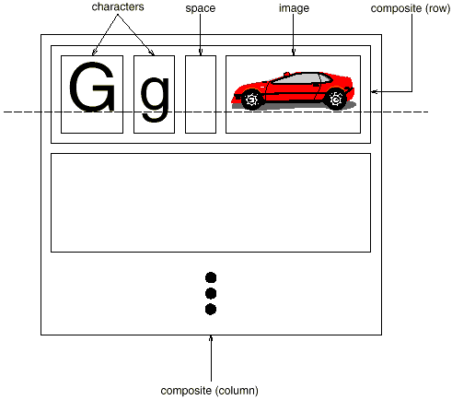
Design Issue #1:
Document Structure
Notes:
Instructor notes
[Copy and paste this text box on notes pages for all slides]

Slide 10
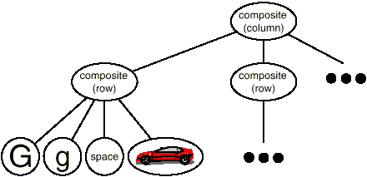
Design Issue #1:
Document Structure
Recursive Composition
A method for representing a hierarchy of information
A grouping of simple items to create a composite item
Groupings of items can be a part of even higher level groups
Notes:
Instructor notes
[Copy and paste this text box on notes pages for all slides]

Slide 11
Design Issue #1:
Document Structure
  Implications
    Objects need corresponding classes
    All of these classes need compatible interfaces
      Allows us to treat them uniformly
  Meet the Glyph
Responsibility | Operations
Appearance | virtual void Draw(Window*) virtual void Bounds(Rect&)
Hit Detection | virtual bool Intersects(const Point&)
Structure | virtual boid Insert(Glyph*, int) virtual void Remove(Glyph*) virtual Glyph* Child(int) virutal Glyph* Parent()
Notes:
Instructor notes
[Copy and paste this text box on notes pages for all slides]

Slide 12
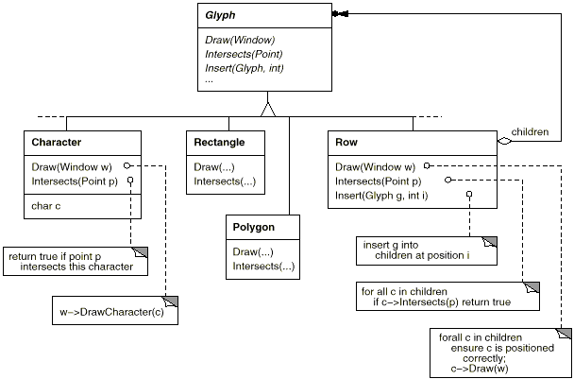
Design Issue #1:
Document Structure
Notes:
Instructor notes
[Copy and paste this text box on notes pages for all slides]

Slide 13
Design Issue #1:
Document Structure
  Recursive Composition – It’s not just for documents
  Useful for any potentially complex, hierarchical structure
  The Composite pattern captures this design approach
      Intent: Compose objects into tree
      structures to represent part-whole
      hierarchies.
      Composite lets clients
      treat individual objects and
      compositions of objects uniformly.
Notes:
Instructor notes
[Copy and paste this text box on notes pages for all slides]

Slide 14
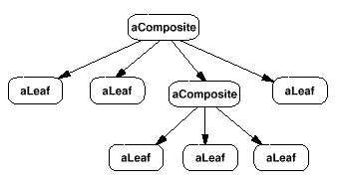
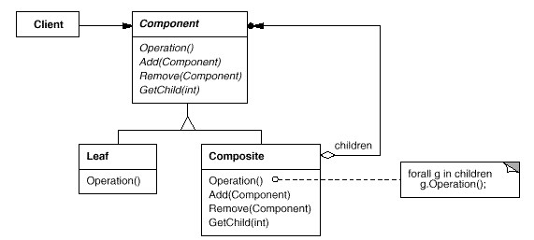
The Composite Pattern
Forwards requests to children
Defines behavior
For the primitives
Behavior for composites
Stores Child components
Notes:
Instructor notes
[Copy and paste this text box on notes pages for all slides]

Slide 15
Design Issue #2
Formatting
How to construct a particular physical structure
    And maintain separation of data and view (format)
Properly formatted document
Some possible responsibilities:
    Break text into lines
    Break lines into columns
    Margin Widths
    Indentation
    Tabulation
    Single/Double Spacing
  Authors restrict the example to breaking glyphs into lines
Notes:
Instructor notes
[Copy and paste this text box on notes pages for all slides]

Slide 16
Formatting
How should we approach formatting?
  What are some important trade-offs?
  Design goals?

Slide 17
Design Issue #2
Formatting
  Important Trade-Off
    Formatting quality vs. formatting speed
    Formatting speed vs. Storage requirements
  It will be complex… so our goals:
    Keep it well-contained
    Independent of document structure
      Add a new glyph… not have to worry about changing format code
      Add new formatting algorithm – not have to change glyphs
Notes:
Instructor notes
[Copy and paste this text box on notes pages for all slides]

Slide 18
Design Issue #2
Formatting
  Needs to be easy to change the formatting algorithm
    If not at run-time, at least at compile-time
  We can make it independent, self contained and replaceable by putting it in its own class
  We can make it run-time replaceable by creating a class hierarchy for formatting algorithms
  Compositor
Responsibility | Operations
What to format | void SetComposition(Composition)
When to format | virtual void Compose()
Notes:
Instructor notes
[Copy and paste this text box on notes pages for all slides]

Slide 19
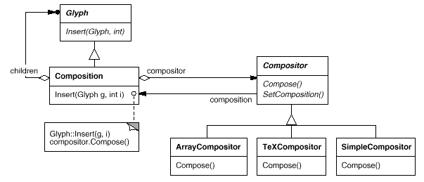
Design Issue #2
Formatting
  Composition object – when created contains the glyphs that determine content, but not structure (such as row, column)
  When Compose() is called, it iterates the glyphs and composes (formats) them.
Notes:
Instructor notes
[Copy and paste this text box on notes pages for all slides]

Slide 20
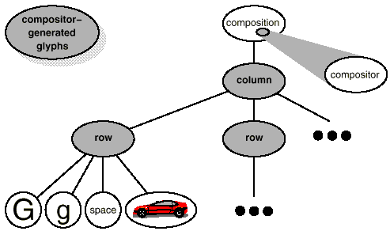
Design Issue #2
Formatting
  Rows and Columns are inserted by the compositor
  Why rows and columns?
    Inserted by the line-breaking algorithm
Notes:
Instructor notes
[Copy and paste this text box on notes pages for all slides]

Slide 21
Design Issue #2
Formatting
  Why do we need different Compositor’s?
    In the Example:
      SimpleCompositor might do a quick pass without regard for such esoterica as the document's "color." Good color means having an even distribution of text and whitespace.
      A TeXCompositor would implement the full TeX algorithm [Knu84], which takes things like color into account in exchange for longer formatting times.
  Compositor-Composition class split ensures a strong separation between code that supports the document's physical structure and the code for different formatting algorithms
  We can change the linebreaking algorithm at run-time by adding a single SetCompositor operation to Composition's basic glyph interface.
Notes:
Instructor notes
[Copy and paste this text box on notes pages for all slides]

Slide 22
Design Issue #2
Formatting
  Have we seen this before?
    Encapsulating an algorithm in an object is the intent of the Strategy (315) pattern.
    Key participants in the pattern are
      Strategy objects (Compositors)
      Context object (Composition)
    The key to using Strategy
      Interfaces for the strategy and the context that will support a range of algorithms
      Ideally we don’t want to change these interfaces to support a new algorithm
Notes:
Instructor notes
[Copy and paste this text box on notes pages for all slides]

Slide 23
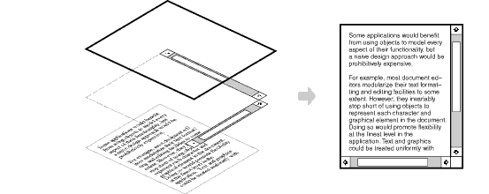
Design Issue #3
Embellishing the user interface
  Two Embellishments
    Add a Border around the text editing area
    Add scroll bars
Notes:
Instructor notes
[Copy and paste this text box on notes pages for all slides]

Slide 24
Design Issue #3
Embellishing the User Interface
  Basically, we want to extend the code to provide a Transparent Enclosure
    Transparent in that the page itself does not know anything about the changes – it behaves the same
  How should we do this?
    We could use Inheritance, how would that look?
    We have a Composition class…
      To add a Border we add a BorderedComposition
      To add a Scroll bar we add a ScrollableComposition
      What about both? BorderedScrollableComposition?
  How could we do it with object composition instead?
    What object “has” what object?
    How do we make it extensible?
Notes:
Instructor notes
[Copy and paste this text box on notes pages for all slides]

Slide 25
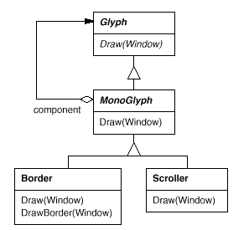
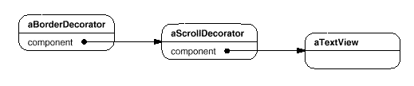
Design Issue #3
Embellishing the User Interface
  This is an example of the Decorator Pattern
  The authors call it the “MonoGlyph”
// I pass the buck…
void MonoGlyph::Draw (Window* w)
{ _component->Draw(w); }
// Extend Draw
void Border::Draw (Window* w)
{
MonoGlyph::Draw(w);
DrawBorder(w);
}
Multiple Embellishments….
Notes:
Instructor notes
[Copy and paste this text box on notes pages for all slides]

Slide 26
Decorator
Related Patterns
  Adapter (139): A decorator is different from an adapter in that a decorator only changes an object's responsibilities, not its interface; an adapter will give an object a completely new interface.
  Composite (163): A decorator can be viewed as a degenerate composite with only one component. However, a decorator adds additional responsibilities—it isn't intended for object aggregation.
  Strategy (315): A decorator lets you change the skin of an object; a strategy lets you change the guts. These are two alternative ways of changing an object.
Notes:
Instructor notes
[Copy and paste this text box on notes pages for all slides]

Slide 27
Design Issue #4
Supporting Multiple Look-and-Feel Standards
  One major problem in portability… consider look-and-feel for
    Windows
    Max OS X
    KDE
  If re-targeting is too difficult (expensive), it won’t happen
  NOTE: Just one of the issues… Look-and-Feel … we deal with the Windowing system itself next
  We use an Abstract Factory Pattern
  This allows us to define the product type at compile time or run-time (based on environment or user input)
Notes:
Instructor notes
[Copy and paste this text box on notes pages for all slides]

Slide 28
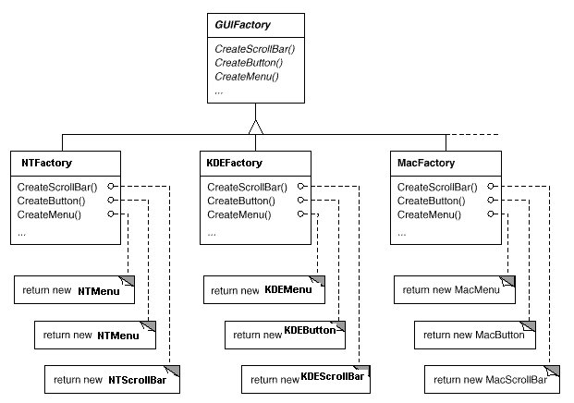
Design Issue #4
Supporting Multiple Look-and-Feel Standards
  // Creating a scrollbar…
  ScrollBar* sb = guiFactory->CreateScrollBar();
Notes:
Instructor notes
[Copy and paste this text box on notes pages for all slides]

Slide 29
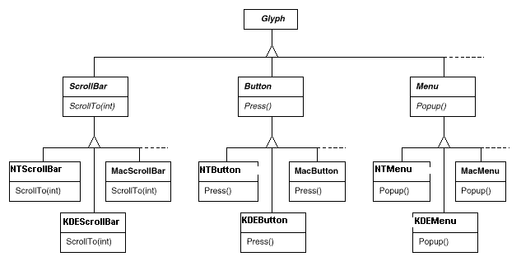
Design Issue #4
Supporting Multiple Look-and-Feel Standards
Notes:
Instructor notes
[Copy and paste this text box on notes pages for all slides]

Slide 30
Abstract Factory
Related Patterns
  AbstractFactory classes are often implemented with factory methods (Factory Method (107)), but they can also be implemented using Prototype (117) [Creation by Cloning].
  A concrete factory is often a singleton (Singleton (127)) [Specify a Single Instance].
Notes:
Instructor notes
[Copy and paste this text box on notes pages for all slides]

Slide 31
Design Issue #5
Supporting Multiple Window Systems
  What about the Windowing System itself?
  The APIs differ… not just the visual elements
    Can we use Abstract Factory?
      Not easily… vendors already define class hierarchies
      How do we make classes from different hierarchies comply to the same abstract type?
    We use Bridge to
      define a uniform set of windowing abstractions (common interface)
      Hide the individual implementations
Notes:
Instructor notes
[Copy and paste this text box on notes pages for all slides]

Slide 32
Design Issue #5
Supporting Multiple Window Systems
  Common things a Window class must do (responsibilities)
    Provide operations for drawing basic geometric shapes
    Maximize/Minimize
    Resize
    (re)draw contents on demand (when restored, overlapped, obscured, etc…)
  Two Possible Philosophies (Extremes)
    Intersection of functionality – Only define what is common to all
    Union of functionality – Incorporate capabilities of all systems
Notes:
Instructor notes
[Copy and paste this text box on notes pages for all slides]

Slide 33
Design Issue #5
Supporting Multiple Window Systems
  We adopt a hybrid
Responsibility | Operations
window management | virtual void Redraw() virtual void Raise() virtual void Lower() virtual void Maximize() virtual void Minimize()
graphics | virtual void DrawLine() virutal void DrawRect() virtual void DrawPolygon() Virtual void DrawText()
Notes:
Instructor notes
[Copy and paste this text box on notes pages for all slides]

Slide 34
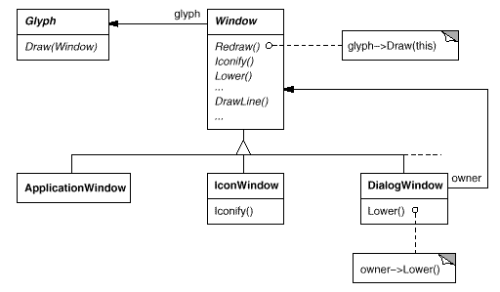
Design Issue #5
Supporting Multiple Window Systems
Notes:
Instructor notes
[Copy and paste this text box on notes pages for all slides]

Slide 35
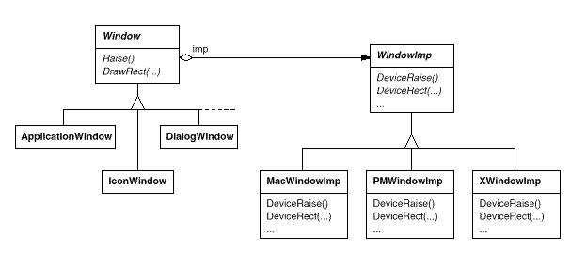
Design Issue #5
Supporting Multiple Window Systems
Notes:
Instructor notes
[Copy and paste this text box on notes pages for all slides]

Slide 36
Bridge Pattern
Related Patterns
  An Abstract Factory (87) can create and configure a particular Bridge
  The Adapter (139) pattern is geared toward making unrelated classes work together. It is usually applied to systems after they're designed. Bridge, on the other hand, is used up-front in a design to let abstractions and implementations vary independently.
Notes:
Instructor notes
[Copy and paste this text box on notes pages for all slides]

Slide 37
Design Issue #6
User Operations
  Possible Operations
    Creating a new document
    Open, save, print a document
    Cut and Paste
    Format text
  We have different interfaces for these operations
    Different Look-and-Feel
    Different Windowing Systems
    Different Access Points (menu, shortcut key, context menu)
  We want independence from the UI
    UI triggers the action, but I don’t depend on the UI
Notes:
Instructor notes
[Copy and paste this text box on notes pages for all slides]

Slide 38
Design Issue #6
User Operations
  Furthermore…
    The operations are implemented in many different classes
    We want to access the functionality without adding dependency between the UI classes and all of the different classes involved
  That’s not all
    We also want to support undo and redo for some functionality
  We need to encapsulate the request using the Command Pattern
Notes:
Instructor notes
[Copy and paste this text box on notes pages for all slides]

Slide 39
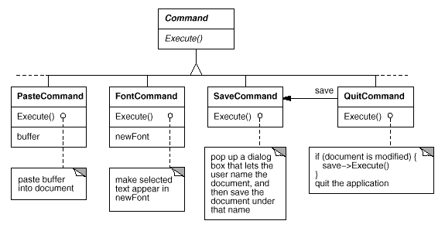
Design Issue #6
User Operations
Notes:
Instructor notes
[Copy and paste this text box on notes pages for all slides]

Slide 40
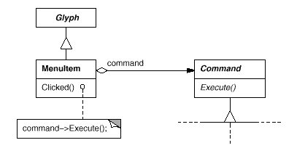
Design Issue #6
User Operations
  Each MenuItem can store an appropriate command
Notes:
Instructor notes
[Copy and paste this text box on notes pages for all slides]

Slide 41
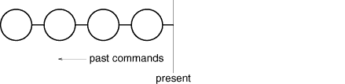



Design Issue #6
User Operations
  What about Undo? We add an Unexecute() method and keep a command history…
UNDO
REDO
Notes:
Instructor notes
[Copy and paste this text box on notes pages for all slides]

Slide 42
Command Pattern
Related Patterns
  A Composite (163) can be used to implement MacroCommands.
  A Memento (283) can keep state the command requires to undo its effect.
  A command that must be copied before being placed on the history list acts as a Prototype (117).
Notes:
Instructor notes
[Copy and paste this text box on notes pages for all slides]

Slide 43
Design Issue #7
Spell Check and Hyphenation
  Similar constraints to formatting
  Need to support multiple algorithms
  We may want to add
    search
    grammar check
    word count
  This is too much for any single pattern…
  There are actually two parts
    (1) Access the information
    (2) Do the analysis
Notes:
Instructor notes
[Copy and paste this text box on notes pages for all slides]

Slide 44
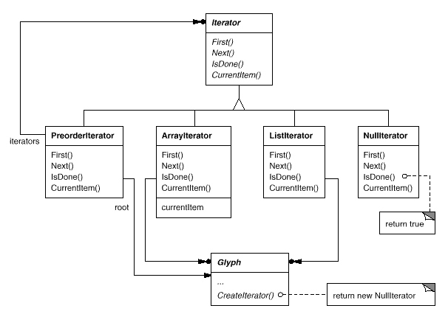
Design Issue #7
Spell Check and Hyphenation – Accessing the Information
  We can encapsulate access and traversal using the Iterator Pattern
    Methods
    void First(Traversal kind)
    void Next()
    bool IsDone()
    Glyph* GetCurrent()
    void Insert(Glyph*)
Notes:
Instructor notes
[Copy and paste this text box on notes pages for all slides]

Slide 45
Design Issue #7
Spell Check and Hyphenation – Accessing the Information
  Using the Iterator to do our analysis…
  An example
  Glyph* g;
  for (g->First(PREORDER);
  !g->IsDone();
  g->Next())
  {
  Glyph* current = g->GetCurrent();
  // do some analysis
  }
Notes:
Instructor notes
[Copy and paste this text box on notes pages for all slides]

Slide 46
Design Issue #7
Spell Check and Hyphenation – The Analysis
  We don’t want our analysis in our iterator
    Iterators can be reused
  We don’t want analysis in our Glyph class
    Every time we add a new type of analysis… we have to change our glyph classes
  Therefore
    Analysis gets its own class
    It will use the appropriate iterator
    Analyzer class accumulates data to analyze as it goes
Notes:
Instructor notes
[Copy and paste this text box on notes pages for all slides]

Slide 47
Design Issue #7
Spell Check and Hyphenation – The Analysis
  We don’t want…
  void SpellingChecker::Check (Glyph* glyph)
  {
  Character* c;
  Row* r;
  Image* i;
  if (c = dynamic_cast<Character*>(glyph))
  {
  // analyze the character
  }
  else if (r = dynamic_cast<Row*>(glyph))
  {
  // prepare to analyze r's children
  }
  else if (i = dynamic_cast<Image*>(glyph))
  { // do nothing }
  }
HARD TO EXTEND
HAVE TO CHANGE WHEN
WE CHANGE GLYPH HIERARCHY
Notes:
Instructor notes
[Copy and paste this text box on notes pages for all slides]

Slide 48
Design Issue #7
Spell Check and Hyphenation – The Analysis
  Instead… we use the Visitor Pattern
  class Visitor
  {
  public:
  virtual void VisitCharacter(Character*) { }
  virtual void VisitRow(Row*) { }
  virtual void VisitImage(Image*) { }
  // ... and so forth
  };
  Then, we can define
    SpellCheckingVisitor
    HyphenationVisitor
  Within Glyph we define an operation
    void VisitMe(Visitor& visitor)
      Character class would call visitor.VisitCharacter(this)
      Row class would call visitor.VisitRow(this)
Notes:
Instructor notes
[Copy and paste this text box on notes pages for all slides]

Slide 49
Visitor Pattern
Related Patterns
  Composite (163): Visitors can be used to apply an operation over an object structure defined by the Composite pattern.
  Interpreter (243): Visitor may be applied to do the interpretation.
    Embedding of a domain specific language or scripting language within an application
Notes:
Instructor notes
[Copy and paste this text box on notes pages for all slides]

Slide 50
Next Week
  Return to our Pattern-per-week strategy
  Read about the Decorator Pattern
Notes:
Instructor notes
[Copy and paste this text box on notes pages for all slides]

Slide 51
Thank You

Slide 52


